Slide 1
OpenAI + Google Doc + Google Calendar Integration Final CSC215-AI Project
Vishakha Ramteke

Slide 2
Different Programs
Basic
Querying Own Data(text file) with no OpenAI Integration
b) Querying Own Data(text file) with OpenAI Integration
c) Querying Own Data(folder) with no OpenAI Integration
d) Querying Own Data(folder) with OpenAI Integration

Slide 3
2) Retrieving the doc content from the Google docs and running the above four different basic operations on it.
3) Complete integration of Chat GPT, Goggle Docs and Goggle Calendar – Available Time slots given manually in the Google Doc.

Slide 4
4) Complete integration of Chat GPT, Goggle Docs and Goggle Calendar - Automatic retrieval of Available timeslots from the Google Calendar into Google Doc.

Slide 5
FLOW CHARTS FOR 3RD AND 4TH PROGRAMS

Slide 6
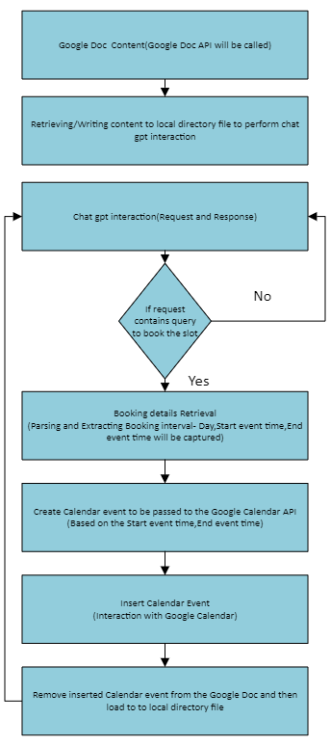

Slide 7
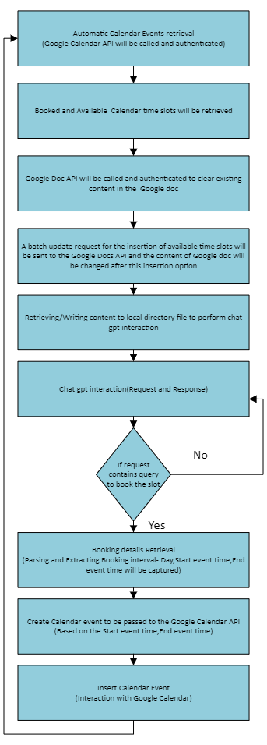

Slide 8
THANK YOU!!!!!

